Slide 1
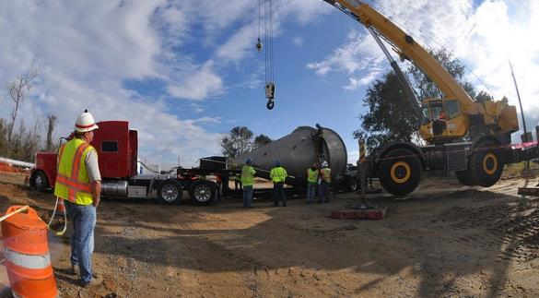
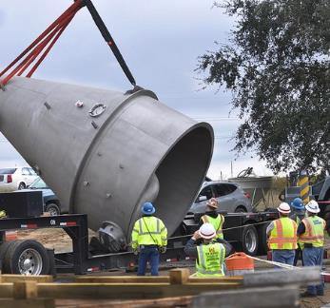
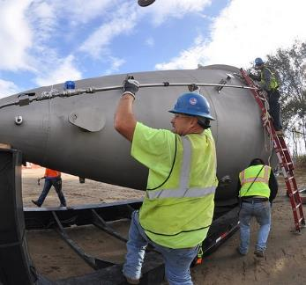
[Program / project name]
Mega Project Semi-Annual Update
[Name]
[MSC] [Title]
[DD Month YYYY]
Notes:
[Name] will typically be the MSC Senior Project Executive, SES – the responsible party for briefing the Directors of CW and/or MP. Please note that this template must be used at a minimum for USACE’s Mega Project briefings. The Senior Project Executive may add additional slides at their discretion. Teams are encouraged to develop slide decks that can be used interchangeably with stakeholders in other forums (e.g. Air Force SAG, SERG).

Slide 2
Instructions
Project/program specific briefing approach should be outlined in the PMP/PgMP for each mega project.
For multi-phase projects and programs, a rolling wave scheduling and EVMS approach may be required. The briefing template should depict that rolling wave.
The MSC’s Senior Project Executive (SPE) is responsible for establishing project specific and objective metrics when enterprise standards do not apply. Metrics can (and should) change as project phases change. Metric control bands and R-Y-G ratings will be fully explained on the slides, or in the ‘notes’ section for each slide.
Metrics and evaluation period(s) should be chosen to reflect the current briefing period/cycle, demonstrating trends and projecting estimates at completion (for both cost and time) using current/recent data.
Contingency (cost and time) establishment, monitoring, consumption, and management should be addressed when briefing S Curve data.
Project and program unique performance metrics (for example, amount of risk reduction for dam and levee safety projects) should be developed and briefed for each project/program.
Additional instructions are included in the ‘notes’ section of the following slides.
Any text within [brackets] is to be edited.
Questions on how to communicate something for your project? Just ask!
**MSCs have the option of using other formats for briefing Semi-Annual Updates as long as all salient information in this template is communicated.**
Notes:
Recommend using a BLUF / summary of needed decision if needed for a Quarterly Update.
MSCs/PDTs are encouraged to submit their Quarterly Updates in PowerPoint file format such that these ‘notes’ sections can be used to further explain data, metrics, etc.

Slide 3
[PROJECT NAME] - Overview
Authorization: Note: include legislation(s) or approval document, authorized cost in legislation(s)/approval document, and current inflated cost (FY23 price level)
Purpose/Description:
Briefly Explain what this project was authorized to construct (project purpose) and the major features.
Schedule: Note: include original (at authorization) & current l operational date, and original & current project completion date. If operational date and/or project completion date has since last update, include prior dates and new dates.
Cost: Note: include current fully funded cost estimate, certification date, and design maturity associated with cost estimate. If cost update is ongoing include scheduled completion date. If cost estimate has changed since last meeting, include significant change, reasons for change as well prior and new cost estimate.

Slide 4
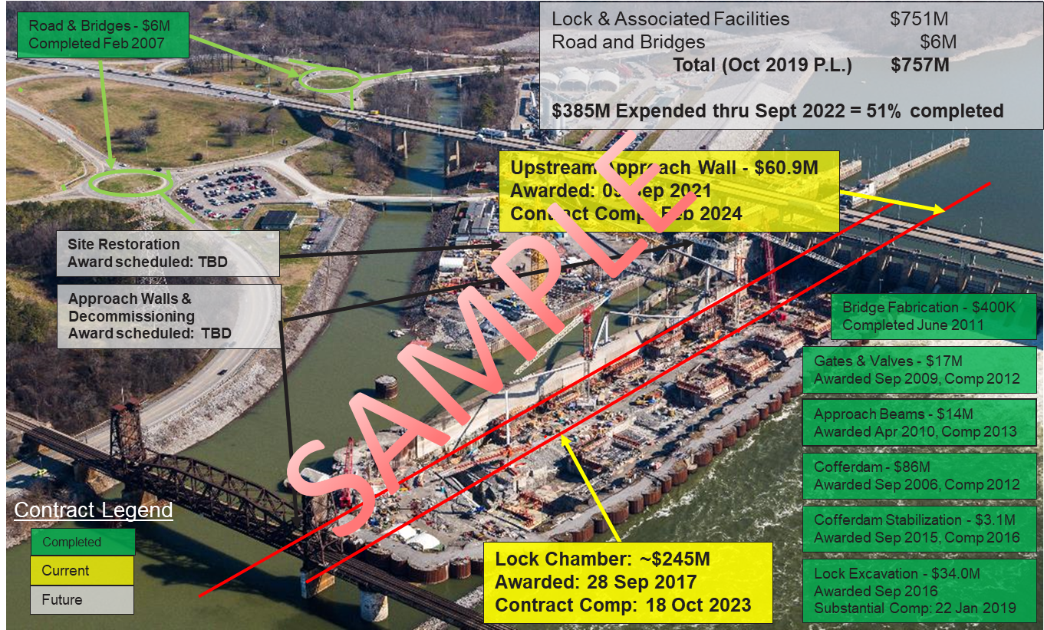
[program / project name] overview
[Narratives]
Notes:
Example: Chickamauga Locks & Dam. This slide should have a project overview image / story board / rendering that communicates different contracts, phases, levels of completion, etc. For projects under construction, aerial photographs work well with color coded phases/contracts if needed. For projects in PED/Design, site images with proposed design features are acceptable. A brief narrative with project facts may work as well. In the event a story board or ‘placemat’ is not legible when scaled to the slide it may be submitted separately (recommended for first submission and updated annually).

Slide 5
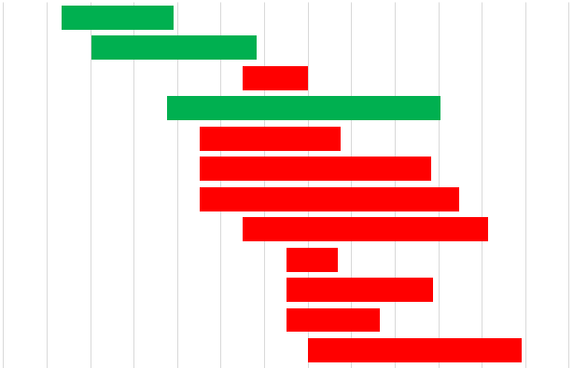
[program / project name] Schedule
FY20
FY21
FY22
FY23
FY24
FY25
FY26
FY27
FY28
FY29
FY30
Upper Channel Deepening– Phase 1 Base
Bars represent period of performance for work described.
Upper Approach Wall – Phase 2 Base
Upper Approach Wall – Phase 2 Options
New Third Lock – Phase 3 Base
U/S Wide Wall Monoliths – Phase 3 Opt 1A
SAMPLE
Chamber Wall Monoliths – Phase 3 Opt 1B
New Pump Well Completion – Phase 3 Opt 2
Lock Operational – Phase 3 Opt 3
Downstream Work – Phase 3 Opt 4
Hands Free Mooring – Phase 3 Opt 5
Funded Work
Unfunded Work, includes contract, contingency, and labor
D/S Ship Arrestor – Phase 3 Opt 6
Remaining Labor
WE ARE HERE
Note: include schedule for remaining work phases to show work progression. At a minimum show all construction contracts award date and construction work (all phases) with start and end dates thru project completion.
Notes:
Example: Chickamauga Locks & Dam. This slide should have a project overview image / story board / rendering that communicates different contracts, phases, levels of completion, etc. For projects under construction, aerial photographs work well with color coded phases/contracts if needed. For projects in PED/Design, site images with proposed design features are acceptable. A brief narrative with project facts may work as well. In the event a story board or ‘placemat’ is not legible when scaled to the slide it may be submitted separately (recommended for first submission and updated annually).

Slide 6
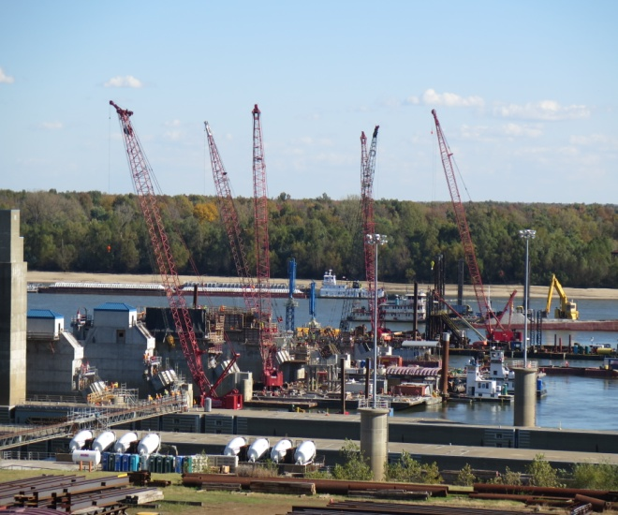
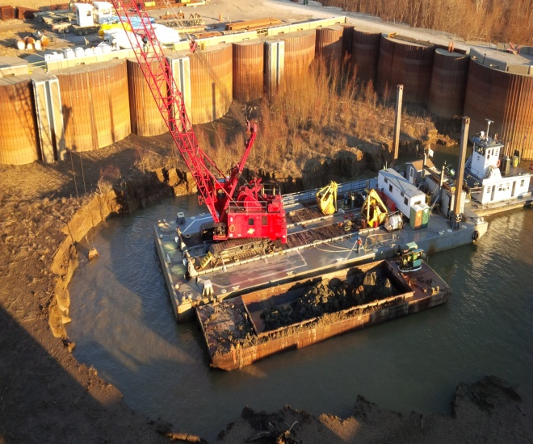
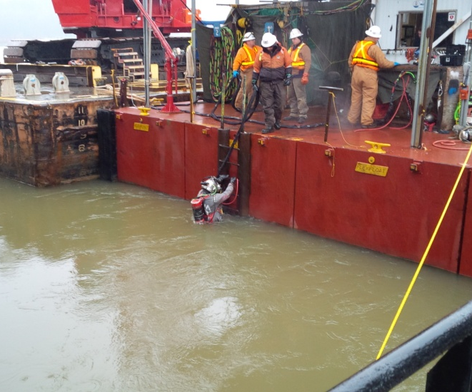
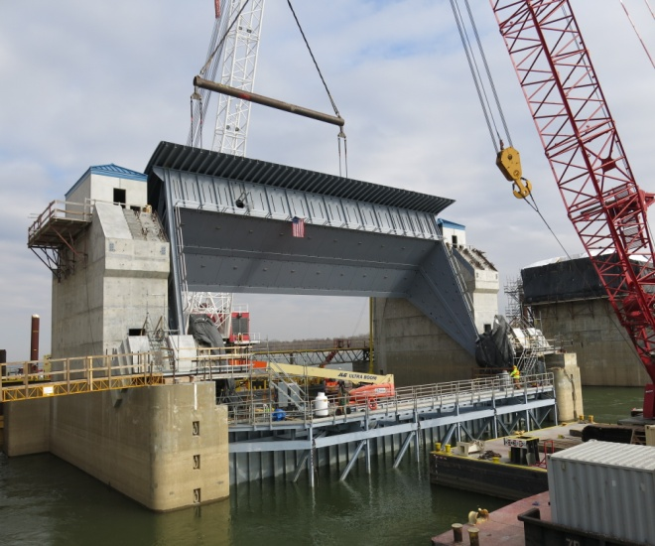
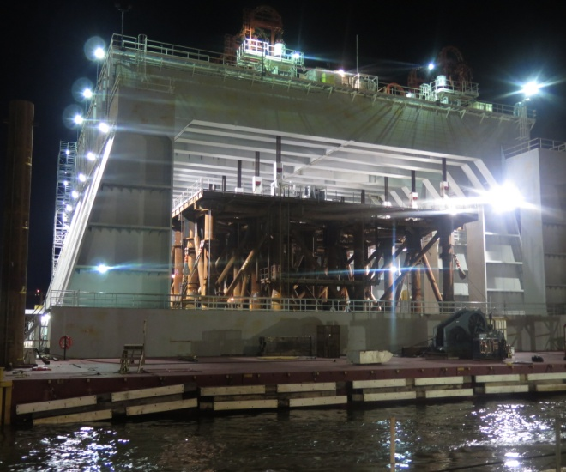
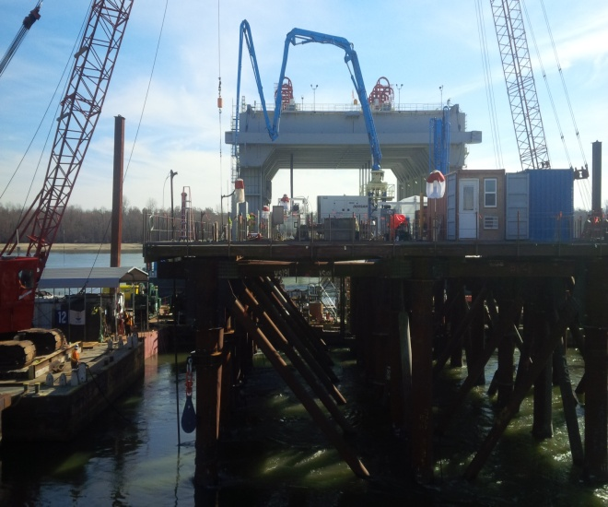
Progress photos
1
2
3
4
5
6
1. Upper Pier Build-out (Nos. 1-6) 2. Dredging Boat Harbor 3. Deploying Diver
4. TG-1 installation 5. NP-2 Placement 6. NP-2 Tremie Placement
Notes:
Example: Olmsted Locks & Dam. Use as few/many project photos for this slide. A brief caption / title is helpful, and of course can be further explained here in the notes section.

Slide 7
Time & Cost scorecard
Budget Metric
Schedule Metric
Planned (BCWS): $[XXX]M
Earned (BCWP): $[XXX]M
Actual (ACWP): $[XXX]M
[Narrative and/or table]
Target: [Insert metric / control bands info here]
Completion | Baseline | Current
Contract A | 16 Jun 1775 | 17 Aug 2018 (A)
Contract B | 04 Jul 1776 | 28 Nov 2018 (A)
Deliverable 1 | 11 Nov 1919 | 30 Apr 2017
[Narrative if needed]
Target: [Insert metric / control bands info here]
Budget Metric
Milestone status for next X months
Baseline: $[XXX]M
EAC: $[XXX]M
[Auth or PA]: $[XXX]M
[Narrative if needed]
Target: [Insert metric / control bands info here]
Activity | Baseline | Current
Activity 1 | 16 Jun 1775 | 17 Aug 2018 (A)
Activity 2 | 04 Jul 1776 | 28 Nov 2018 (A)
Milestone Z | 11 Nov 1919 | 30 Apr 2017
[Narrative if needed]
Target: [Insert metric / control bands info here]
Notes:
Budget Metric: This metric and control bands will be program and project specific for the current period. A tabular and narrative explanation should be included here, and may be graphically depicted on separate bar charts and/or cumulative curves.
Time Metric: This metric represents planned, current, and revised completion dates, based on the current period and latest available information. Control bands should be based on assigned contingency and management reserve values as depicted on the project S-Curve.
Estimated Cost at Completion: This metric should be based on and tied to current update of the S-Curve. The formula for determining EAC should be clearly stated and demonstrated (schedule, cost or composite). Control bands should be based on assigned contingency and management reserve values, as depicted on the S-Curve slide. Include the date of the CWE that is used to develop the EAC, and date of last certified estimate (if applicable).
Milestones: This metric should represent major milestones anticipated in a 6 month planning window. The planned and current status of each milestone, and the criticality of the path on which that milestone resides should be represented in a tabular fashion. These can also be graphically depicted on separate Gantt charts added to an additional slide if R-Y-G tracking is desired for separate activities, or additional space is needed to depict relationship between milestones. Control bands should be based on available float values and/or project specific values.

Slide 8
Design & Construction Management Scorecard
Acquisition
Quality of Design
[Narrative and/or table]
Target: [Insert metric / control bands info here]
[Narrative and/or table]
Target: [Insert metric / control bands info here]
Quality of Construction
Safety
[Narrative and/or table]
Target: [Insert metric / control bands info here]
Notes:
Acquisition: Acquisition plan status and necessary approvals / action items. This metric and control bands will be program / project specific. These should capture, in tabular or % and narrative fashion, critical program / project specific acquisitions. Solicitation & post-award activities, protests, significant changes, REAs, claims and disputes should be identified here. All items should indicate affected milestones in the IMS.
Quality of Design: Objective, project specific metrics for Quality of Design must be created/approved by the Senior Project Executive. Additional items to be communicated here include: results of PDRI (output of designs evaluated against design schedule / required quality); adequacy and implementation of Quality Management Plans for design activities; evaluation of earned value of design; Lead Engineer / Technical Lead involvement; upcoming risk areas being designed. Communicate status and impacts (if any) of design criteria changes. For Design-Bid-Build or similar type of acquisition, evaluate DDC expenditures, design re-work, and performance of Designer of Record (AE or in-house) support during construction. Other examples of objective metrics include errors/omissions tracking, % of RFIs leading to changes (engineering or other), AE liability impacts, etc.
Quality of Construction: Objective, project specific metrics for Quality of Construction must be created/approved by the Senior Project Executive. These metrics should demonstrate Quality Management efforts for construction activities and the level(s) of quality being achieved in constructed products / facilities. The metrics should reflect performance of USACE QA and Contractor QC performance. Examples may include number and age of deficiencies noted, measures of cost or impact of these defects, Contractor submittal quality (% of C/E codes), variances from contract documents (as submitted or as built), and S&A rates.
Safety: Communicate performance of the Government and/or Contractor’s Safety and Accident Prevention Program(s). Identify upcoming highest areas of risk during construction. As a minimum, report USACE standard safety metrics (DART) against USACE tolerance levels.

Slide 9
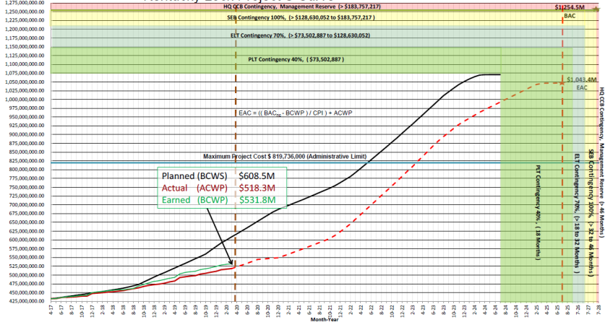
Project s-curve
[Narrative]
Notes:
Contingency bands should be determined from formal Cost and Schedule Risk Assessments and regularly updated according to the specific program requirements. Management Reserve value for Cost is the remaining amount between the CSRA calculated Total Project Cost and the administrative (for Civil Works , the “902” limit , for MILCON the Programmed Amount) limit for the project. Time contingency will be based on the current CSRA – time management reserve will be set based on suggestion of the SPE, reviewed by HQ, and incorporated into the PMP.
Earned Value Work Instructions are currently located here: https://cops.usace.army.mil/sites/PPM/tools/Plan/Forms/AllItems.aspx
The example provided in this slide was automated out of the CEFMS/EDW Earned Value universe, “EVM Curve” report. Some manual clipping of report outputs will be needed for creation of this slide.
Other examples are posted to the Quarterly Update SharePoint site noted in the ECB.

Slide 10
Project Decisions
Project Decisions Made
  [Item 1…]
  [Item 2…]
  [Item 3…]
Upcoming Project Decisions
  [Item 1…]
  [Item 2…]
  [Item 3…]
Outstanding Technical Questions
  [Item 1…]
  [Item 2…]
  [Item 3…]
Notes:
Decisions should be tied to project milestones in the IMS. The intent of this slide is to communicate key items being discussed within the three tiered governance structure, to include planning, design, acquisition and construction.
Project Decisions Made: This section may include items such as directions given to Contractors, agreements reached that were elevated in the dispute resolution matrix, and internal PDT decisions on acquisition, etc.
Upcoming Project Decisions: Expand upon PDT decisions or approvals that were identified in the previous milestones quadrant.
Technical Decisions: This section should identify key technical decisions related to planning studies, resolution of criteria conflicts (i.e. work for others), or acceptance / rejection of Contractor work.

Slide 11
Current Critical Issues
[Critical Issue A]
[Critical Issue B]
[Critical Issue C]
Actions needed from HQUSACE
  [Item 1…]
  [Item 2…]
  [Item 3…]
[DD Month YYYY] Mega DCE Report Action Items
  [Item 1…]
  [Item 2…]
  [Item 3…]
Notes:
As noted in the ECB, the Senior Project Executive must communicate status on items identified in recent Mega DCE Reports. This slide should also communicate other critical issues that are ongoing.
The Ball-in-court at HQ section is the opportunity to note if the PDT needs support from any of the HQ offices, Directors, or General Officers. Examples include coordination with other DoD offices, HQUSACE approvals, and support for Congressional inquiries.

Slide 12
Risk Management
[Risk #1]
  [Description]
  [Risk decision / ongoing action]
[Risk #2]
  [Description]
  [Risk decision / ongoing action]
…
[Joint Risk Register Item X]
  [Description]
  [Joint mitigation efforts]
…
Notes:
The Risk Register should be regularly updated, and tied to the CSRA and milestones in the IMS. Results of the CSRA are summarized in sensitivity charts for cost and schedule that identify the risks with most likelihood and severity of impact. These should be annotated here and regularly updated.
Once a Construction contract has been awarded, the PDT should include the top two or three line items from the contract’s Joint Risk Register as well.

Slide 13
Summary of team partnering assessment
Category | TEAM PERFORMANCE FEEDBACK CRITERIA | Rating
Project Delivery Mindset | Puts successful delivery of the mission first, addressing the requirements of the mission before the goals and requirements of any one organization.
Project Delivery Mindset | Continually assesses and adjusts performance as needed to ensure successful project delivery outcomes.
Communication | Communicates in a respectful, professional, and productive manner
Communication | Adheres to proper communication protocols
Communication | Displays and promotes behaviors that foster trust (honesty, transparency, and integrity, active listening, and seeking to understand)
Communication | Listens actively and Seeks to under
Teamwork | PDT members are accountable, taking full ownership, honoring commitments
Teamwork | Leadership is accessible, accountable, proactive, and supportive.
Teamwork | Works to creatively solve issues in a timely fashion at the lowest appropriate level and elevating per the issue resolution hierarchy when necessary
Quality Management | Implements and/or supports an effective overall quality management program aimed at minimizing issues or re-work while meeting contractual requirements
Quality Management | Supports the design, planning, and execution of an effective commissioning program through early integration
Schedule Management | Collectively works to address potential slippages and mitigate/avoid negative impacts
Schedule Management | Establishes and meets agreed-upon milestones required to successfully deliver the project.
Change Management | Looks ahead and engages in early coordination of issues that may require a change or merit determination to understand the scope and criticality and minimize impacts
Change Management | Openly communicates and facilitates resolution of differences during the negotiations phase of changes.
Change Management | Supports the change management process and collective project goals for changes
Written Feedback | What is 1 Success- Something working well within the team? Please do not identify specific personnel or issues but an aspect of the partnering relationship.
 | Answer:
Written Feedback | What is 1 area that could be could be “adjusted” within the team? Please do not identify specific personnel or issues but an aspect of the partnering relationship.
 | Answer:
Provide summary roll up (graphic or other) showing the averages / results / trends of most recent Team Partnering Assessment.
[Narrative and/or schedule of upcoming Partnering events]
Notes:
Mega Projects ECB enclosure #4 is the template for conducting Team Partnering Assessments. The intent of this slide is to communicate the results of those surveys and as such the format may be adjusted from the above. In many cases, Partnering Facilitators distribute summaries after these assessments take place and those deliverables can be shared in these slides.

Slide 14
Summary of Performance goals
Collective Performance Goals Tool
Resident Office
Contract Number
Contract Name
INSTRUCTIONS: At minimum, the Government and Contractor shall meet at the project initiation (or pilot initiation for projects under) and establish the agreed upon goals. It is preferred that the entire PDT participate in the setting to achieve maximum buy-in to the process. At least quarterly, teams shall review their performance against their goals identifying potential actions to be taken when the goal is not being achieved and actions necessary to sustain performance meeting or exceeding the goal.
Collective Performance Goal |  | Action By | Goal | Review 1 | Review 2
Submittals
Review time for Government review required submittals (days) |  | Government
Percentage of resubmittals |  | Contractor
Time from return to resubmission (days) |  | Contractor
Communications (days)
RFI response time |  | Government
Time from RFI Submission to impacted activity start |  | Contractor
Time to respond to correspondence requiring an answer |  | Both
Time to resolve issues identified in correspondence |  | Both
Changes (days)
Time from RFP to valid proposal received |  | Contractor
Time to settle modifications after proposal received |  | Both
Time from settlement to modification executed |  | Government
Provide summary roll up (graphic or other) showing the averages / results / trends of most recent update to the Project Goals Tool.
[Narrative explaining trends, actions, etc.]
Notes:
Mega Projects ECB enclosure #4 is the template for implementation of the Performance Goals Tool. The intent of this slide is to communicate the results of those metrics and as such the format may be adjusted from the above.
PDTs are encouraged to include additional metrics and/or Key Performance Indicators with this information.
This slide can be excluded from a Quarterly Update if there are no active construction contracts.

Slide 15
DISCUSSION

